Slide 1


Strategic Insights for
Mitron Bank’s
New Credit Card Line
Prepared By:- Meet Modi

Slide 2
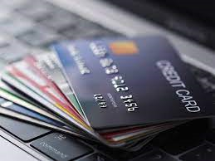
Problem Statement & Goal
Dashboard
Credit Card Feature Recommendations
Spending Insights & Income Utilization
Project request
Demographic Classification
Key Customer Segments
3
4
CONTENTS
6
7
9
11
14

Slide 3

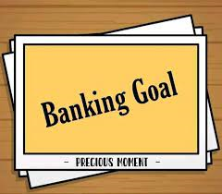
Problem Statement
Mitron Bank wants to launch new credit card to expand its services, but there’s uncertainty. To address this , I as a data analyst, need to analyze a sample dataset of 4000 customer’s online spending habits across Five cities . The goal is to provide Insights that help Mitron Bank tailor the credit cards to customer needs and market trends.
Goal
My Goal is to analyze the sample data, create impactful metrics and visuals, and develop a user-friendly dashboard for Mitron Bank’s leadership . The Objective is to deliver is to deliver data-driven recommendations to Mr. Bashnir Rover, supporting the successful launch of the new credit card line.

Slide 4
Project Request
Avg income utilisation %
Find the average income utilization % of customers (avg spends /avg income). This will be your key metric. The higher the average income utilization %, the more is their likelihood to use credit cards.
Spending Insights
Where do people spend money the most? Does it have any impact due to occupation, gender, city, age etc.? This can help you to add relevant credit card features for specific target groups.
Demographic classification
Classify the customers based on available demography such as age group, gender, occupation etc. and provide insights based on them.
Credit Card Feature Recommendations
Provide recommendations on what key features should be included in the credit card which will improve the likelihood of credit card usage. This should be backed by the insights from data provided and also some secondary research on the internet for this.
Key Customer Segments Demographic classification
By doing above, you should be able to identify and profile key customer segments that are likely to be the highest-value users of the new credit cards. This includes understanding their demographics, spending behaviours, and financial preferences.

Slide 5
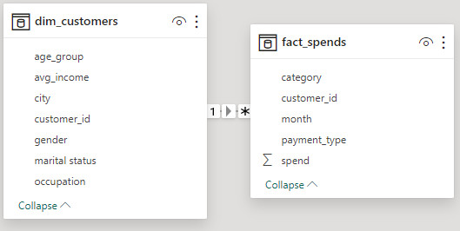
Data Model
.
Customer Demographics
The Dataset include information on the demographics of 4000 customers, such as age, gender, and occupation.
Online spending patterns
The dataset captures the online spending behavior of customers, including transaction amounts and categories.
Geographical Distribution
The dataset covers five cities, providing insights into the spending patterns of customers indifferent locations.

Slide 6

https://app.powerbi.com/groups/me/reports/42ea9c4c-7801-4c07-b8cf-475ed53061b7/ReportSection?bookmarkGuid=920f9cb7-e205-4ed9-ab3c-734744702a07&bookmarkUsage=1&ctid=df8679cd-a80e-45d8-99ac-c83ed7ff95a0&portalSessionId=1e1c3c78-5ccd-4510-8888-f9d29484e962&fromEntryPoint=export

Slide 7
Demographic Classification
For demographic classification, I have conducted a thorough customer demographic analysis using Power BI, and here are the key findings presented In a visually engaging manner :
Total Customers: The dataset encompasses a substantial pool of 4000 customers, forming the foundation of our analysis.
Gender Distribution: I observe a distinct gender distribution:
Total Male Customers: 2597 (64.93%)
Total Female Customers: 1403 (35.08%)
Customers by Age Group: The utilization of a Clustered Column Chart has allowed us to dissect the age distribution with a nuanced perspective:
The age group 25-35 emerges as the dominant segment with 1498 customers, comprising 966 males and 532 females.
Following closely, the age group 35-45 commands 1273 customers, demonstrating a nuanced breakdown of 834 males and 439 females.
Notably, the 45+ age group exhibits the smallest customer count, standing at 538.

Slide 8
Customers by City: Mumbai stands out with the highest customer count at 1078, delineating 693 males and 385 females.
Other cities follow suit:
Chennai: 834
Bangalore: 751
Delhi NCR: 744
Hyderabad: 503
Customers by Occupation:
Salaried IT Employees emerge as the predominant category with 1294 customers, comprising 721 males and 573 females.
Other significant categories include Salaried Other Employees (893), Freelancers (784), Business Owners (630) and Government Employees (399).
Customers by Marital Status: A Donut Chart has been employed to visualize the marital status distribution
Married customers dominate the landscape, constituting a substantial 78.41% of the total customer base (3136 customers)
Unmarried customers account for 21.6% totaling 864 individuals.

Slide 9
Spending Insights & Income Utilization
For Spending Insights and Income Utilisation , I have conducted a thorough customer Spend Analysis using Power BI, and here are the key findings presented in a visually engaging manner:
Key Metrics:
Total Income : 1240M
Total Spends : 531M
Average Income Utilization : 42.82%
Income, Spend, Utilization by Age Group:
Age group 25-34 exhibits the highest income, spend, and utilization (43.66%).
Second-highest is the 35-45 age group with a utilization rate of 46.52%.
Total Spends by Category:
Highest spending in bills category (105M).
Other significant categories: Grocery (86M), Electronics (80M), and the least in Others category (16M).
Income, Spend, Utilization by Occupation:
Salaried IT employees lead in income ($477M), spend ($244M), and utilization (51.04%).
Business Owners show an income of $265M, spend of $88M, and a utilization rate of 33.22%.
Government employees have the lowest utilization at 29%.

Slide 10
Income, Spend, Income Utilization by City:
Mumbai outshines with the highest income and spend, resulting in a utilization rate of 51.43%.
Total Spend by Payment Type:
Credit cards dominate spending, accounting for $216M with a utilization rate of 17.45%.
Total Spend by Gender:
Males lead in spending with $357M, while females contribute $154M.
Spend by Marital Status:
Married individuals top the spending charts with $429M, surpassing unmarried individuals at $102M.
Total Spend by Month:
September emerges as the highest spending month, accounting for $116M, constituting 21.84% of the total spend
Income Utilization by Gender:
Males exhibit a higher income utilization rate at 44.39%, compared to females at 39.92%.
Income Utilization by Marital Status:
Singles show a utilization rate of 43.06%, slightly surpassing married individuals at 42.77%.

Slide 11
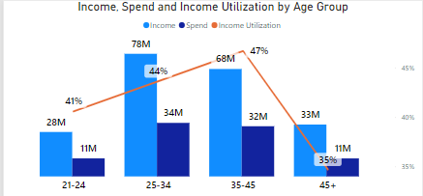
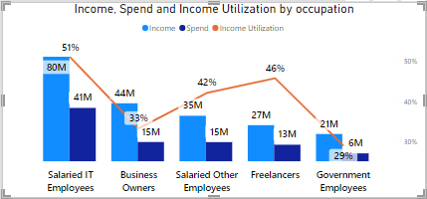
Key Customer Segments
The in-depth analysis encompassing demographics, spending behaviors, and financial preferences has unraveled key customer segments poised to become high-value users of the new credit cards. This profiling delves into nuanced insights, providing a strategic lens for tailored offerings
1.Demographic Profiling:
Age Group Dynamics:
The age group 25-34 and 35-45 emerges as a significant segment, demonstrating higher income, substantial spending, and a utilization rate of 43.66% and 46.72%
This age bracket showcases a balance between income, spending habits, and a keen inclination towards credit card utilization.
Occupation Influence:
Salaried IT employees, Salaried Other Employee, Freelancers constituting a substantial portion, are potential high-value users, given their elevated income, considerable spending, and a utilization rate of 51.04%, 42.10%, 45.80%.

Slide 12
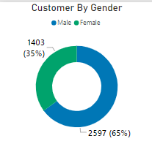
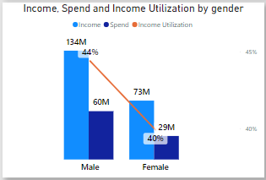
Key Customer Segment
2.Gender-Based Considerations:
Male Gender Dynamics:
The gender-based analysis accentuates that males, on average, earn and spend more than females, displaying a higher utilization rate.
This implies that males, with their elevated financial activity and utilization tendencies, constitute a targeted customer segment for the new credit card offerings.

Slide 13
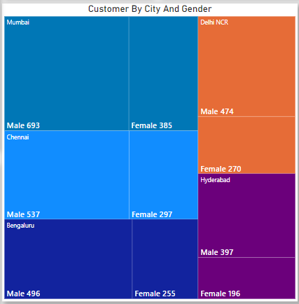
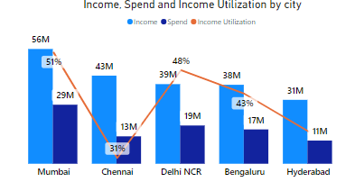
Key Customer Segment
3.City-wise Considerations:
Regional Dynamics:
City-wise variations indicate that customers in cities like Mumbai, Delhi NCR, Bengaluru exhibiting higher income and spending with a utilization rate of 51.43%, 48.03% and 43.46% could be a prime target for credit card offerings.
Tailoring features to align with the spending patterns of customers in specific cities is imperative for capturing high-value users.

Slide 14

Credit Card Feature Recommendations
To maximize credit card usage, it's imperative to design features that resonate with customer behaviors and expectations. The recommendations below are not only rooted in the insights garnered from our extensive data analysis but also supported by findings from secondary research, ensuring a well-rounded approach:
Personalized Rewards :
Insight: The 25-34 and 35-45 age group showcases a strong inclination for credit card utilization.
To enhance the likelihood of credit card usage, especially among the target audience of individuals aged 25-40 who spend and earn more, consider incorporating the following key features into your credit card offerings:
Recommendation: Offer cashback, points, or miles for every transaction, encouraging users to use the credit card for everyday expenses.
A credit card with low or no annual fees is more attractive to potential users.
Allow users to redeem rewards for a variety of options, such as statement credits, travel, merchandise, or gift cards.
Provide higher credit limits to accommodate the spending patterns and financial capacity of the target audience.
Offer attractive sign-up bonuses, such as bonus points or cash rewards upon card activation, to incentivize new users.

Slide 15
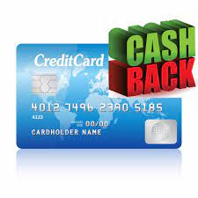


Credit Card Feature Recommendations
Category-Centric Rewards Boost :
Insight: Substantial spending in bills, groceries and electronics.
Recommendation: Enhance rewards for essential spending categories, introducing dynamic cashback rates, loyalty points, or partner discounts, creating a compelling reason for cardholders to use their credit cards frequently.
Forge strategic partnerships with renowned brands, offering cardholders exclusive discounts, early access to sales, or special financing options for products in popular spending categories. Partner with utility companies to offer exclusive discounts or cash back for bill payments made with the credit card.
Collaborate with grocery chains and electronics retailers to provide special promotions or discounts for cardholders.
Extend the warranty on electronic purchases made with the credit card and offer purchase protection, providing peace of mind for expensive items.

Slide 16

Credit Card Feature Recommendations
Tech-Driven Convenience:
Insight: Salaried IT employees , Freelancers , Salaried Other employee represent a significant user base and significant spending.
Recommendation: To improve the likelihood of credit card usage among the identified target customers (salaried IT employees, salaried other employee individuals, and freelancers), consider incorporating the following key features in the credit card:
Introduce specific reward categories that align with the spending patterns of IT professionals, such as technology purchases, software subscriptions, and online services.
Include travel-related perks like airport lounge access, travel insurance, and discounts on flights or hotel bookings, as IT professionals often travel for work.
Partner with popular brands or retailers to offer exclusive discounts, promotions, or special offers for cardholders.
Provide an extended interest-free grace period, particularly for business-related expenses, giving users more time to settle payments without incurring interest charges.

Slide 17

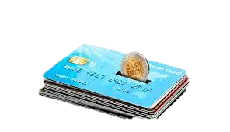
Credit Card Feature Recommendations
Advanced Security Measures:
Insight : Security concerns are paramount for credit card users.
Recommendation: Bolster security features with advanced fraud detection, real-time transaction alerts, and proactive customer support, ensuring cardholders feel secure in their transactions.
Emergency Fund Access:
Introduce features that allow users to access emergency funds at reasonable interest rates, providing a safety net for unexpected expenses.

Slide 18
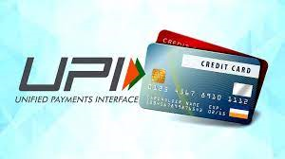
Credit Card Feature Recommendations
RuPay Credit Card Feature:
1. Seamless UPI Integration : Ensure effortless integration with UPI for quick and convenient transactions. Users should be able to link their credit card to UPI easily, promoting widespread usage.
2. Fast Approval Process: Implement a swift and efficient approval process for credit card applications to encourage users to adopt the credit card without unnecessary delays.
Introduce attractive cashback and bonus programs for users making payments through UPI. This will incentivize customers to choose the credit card over other payment methods.

Slide 19


T H A N K YO U
How to rich me ?
Mail modimeet1074@gmail.com
www.linkedin.com/in/meetmodi369

